Slide 1
Programming Fundamentals Lecture #6 Program Control
Junaid Hassan
Lecturer CS & IT Department UOS MBDIN
junaidte14@gmail.com

Slide 2
Repetition Essentials
Most programs involve repetition, or looping.
A loop is a group of instructions the computer executes repeatedly while some loop-continuation condition remains true.
There are two types of repetitons (loops)
1. Counter-controlled repetition is sometimes called definite repetition because we know in advance exactly how many times the loop will execute.
In counter-controlled repetition, a control variable is used to count the number of repetitions.
The control variable is incremented (usually by 1) each time the group of instructions is performed.
When the correct number of repetitions has been performed, the loop terminates, and the program resumes execution with the statement after the repetition statement.

Slide 3
Repetition Essentials
2. Sentinel-controlled repetition is sometimes called indefinite repetition because it’s not known in advance how many times the loop will execute.
Sentinel values are used to control repetition when the number of repetitions is not known in advance, and the loop includes statements that obtain data each time the loop is performed.
The sentinel value indicates “end of data.” The sentinel is entered after all regular data items have been supplied to the program. Sentinels must be distinct from regular data items.

Slide 4
Counter Controlled Repetition
Counter-controlled repetition requires:
1. The name of a control variable (or loop counter).
2. The initial value of the control variable.
3. The increment (or decrement) by which the control variable is modified each time through the loop.
4. The condition that tests for the final value of the control variable (i.e., whether looping should continue)

Slide 5
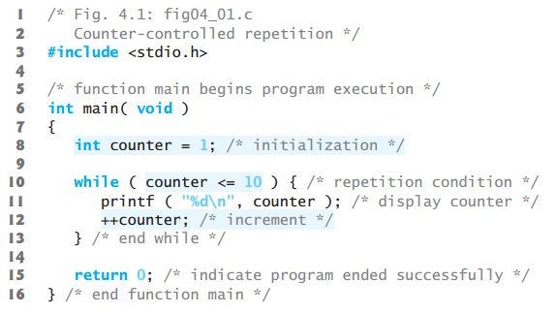
Counter Controlled Repetition

Slide 6
Sentinel-Controlled Repetition
A type of repetition (loop) where the number of executions of the statements is unknown, is called as sentinel controlled repetition.
Simple C program to print user entered number until the entered number is 0
int number1;
scanf(‘%d’, &number1);
while ( number1 != 0 ) {
printf(‘Your entered number is: %d’, number1);
}

Slide 7
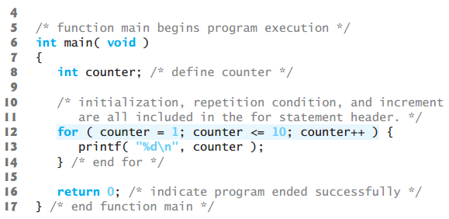
for Repetition Statement

Slide 8
do...while Repetition Statement
The do…while repetition statement is similar to the while statement.
In the while statement, the loop-continuation condition is tested at the beginning of the loop before the body of the loop is performed.
In do…while statement, the loop-continuation condition is tested after the loop body is performed.
Therefore, the loop body will be executed at least once
do {
statement
} while ( condition );

Slide 9
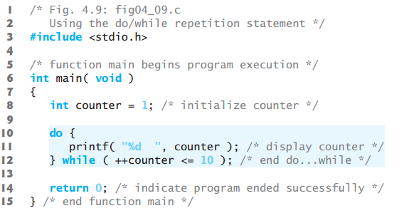
do...while Repetition Statement

Slide 10
switch Multiple-Selection Statement
The switch statement is used to perform different actions based on different conditions
switch(expression) {
case n:
code block
break;
case n:
code block
break;
default:
code block
}

Slide 11
switch Multiple-Selection Statement
scanf(‘%d’, &number1);
switch(number1) {
case 1:
printf(‘you entered 1’);
break;
case 2:
printf(‘you entered 2’);
break;
default:
printf(‘you entered a value other than 1 or 2’);
}

Slide 12
break and continue Statements
The break and continue statements are used to alter the flow of control.
The break statement, when executed in a while, for, do…while or switch statement, causes an immediate exit from that statement. Program execution continues with the next statement
The continue statement, when executed in a while, for or do…while statement, skips the remaining statements in the body of that control statement and performs the next iteration of the loop

Slide 13
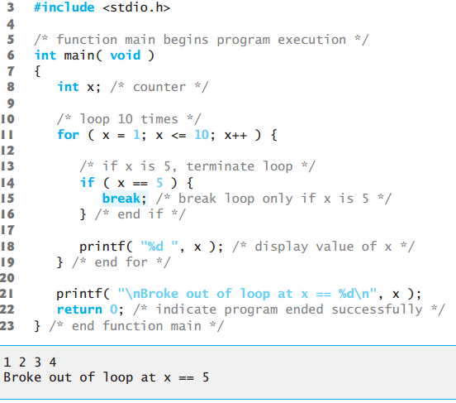
break and continue Statements

Slide 14
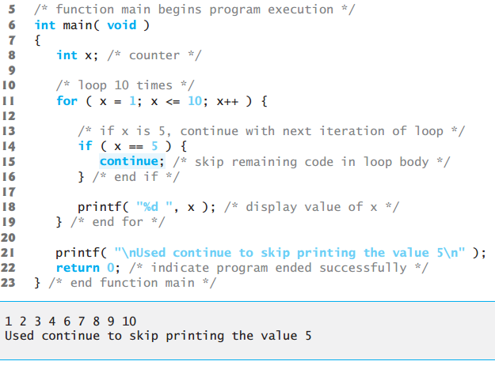
break and continue Statements

Slide 15
Logical Operators
C provides logical operators that may be used to form more complex conditions by combining simple conditions
The logical operators are && (logical AND), || (logical OR) and ! (logical NOT also called logical negation)
if ( gender == 1 && age >= 65 ){ printf(‘both conditions are true’);
}
if ( gender == 1 || age >= 65 ){ printf(‘One of these conditions is true’);
}
if ( age != 65 ){ printf(‘age is not equal to 65’);
}

Slide 16
Confusing Equality (==) and Assignment Operators (=)
Following syntaxt is true:
if(pay == 200){
statement
}
Following Syntax is wrong:
If(pay = 200){
statement
}
int x == 20; (wrong syntax)
int x = 20; (correct syntaxt)

